Slide 1

Ergonomics Semester 2 Week 11

Slide 2
What had been discussed last week
Try OpenSim to obtain the low back compressive force

Slide 3
Timeline
Content | Date | Progress
Learning Basics of Deep Learning | Sep 2022 | Done
Installing VideoPose3D | Sep-Oct 2022 | Done
Learning Ergonomics Basics | Oct-Nov 2022 | Done
Forming a Framework of Time Continuous Cumulative Fatigue
Preparing for Final Exam | Nov-Dec 2022 | Done
Review the Time Continuous Cumulative Fatigue Framework | Dec 2022 | Done
Trying to Extract Coordinates Using Alphapose/Openpose | Dec 2022
Adding on a Cumulative Fatigue Assessment using VideoPose3D with Python | Jan-Mar 2023
Writing a Technical Report for our Research | Mar 2023

Slide 4
Learning Progress of How to Use OpenSim
Inverse Kinematics
Inverse Dynamics
matlab
.trc
(Our Goal)
Vicon’s output
.c3d file
External forces
matlab
.mot
***
VideoPose3D’s output is only 3D coordinates. Hence, we have insufficient data compared to the output of Vicon
Tutorial link：
https://www.bilibili.com/video/BV1Wt4y1n7uX/?spm_id_from=333.788&vd_source=6e380ccb0d7a82414250ff3d722d2770

Slide 5
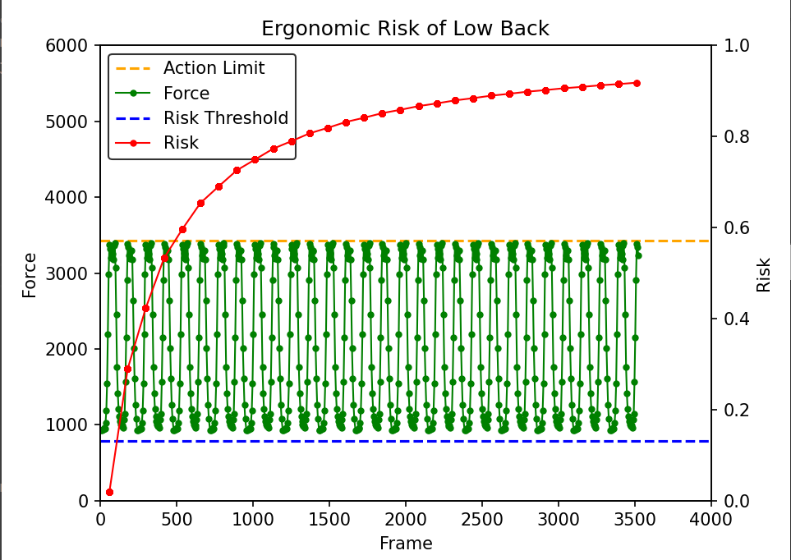
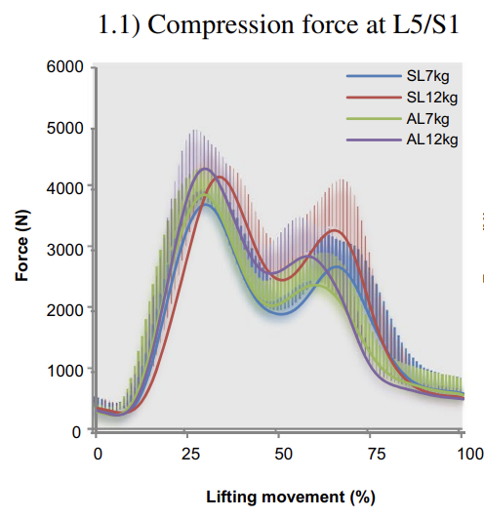
Our Method VS OpenSim
Results from a research paper
a = 10
Body weight = 600N
Repetition = 30
Load = 70N
Body weight = 600N
Repetition = 1
Load = 70N
Estimation of lumbar spinal loading and trunk muscle forces during asymmetric lifting tasks application of whole body musculoskeletal modelling in OpenSim

Slide 6
Challenges of This Week
The doors are still open as long as we can find out what information needs to be filled out in the .c3d file then we can convert. However, I feel like OpenSim is designed for the conventional marker-based motion capture system, it’s not user friendly to visual-based motion capture system. Therefore, this conversion could be very complex.

Slide 7
Virtual Meeting, Summit, Symposium
Virtual Office Hours for Biomechanical Modeling or Machine Learning Research Questions
Date: 8 – 12 May 2023
Venue: Online
Deadline: 21 April 2023
Models & Sensors to Measure Real-World Muscle Function & Movement
Date: 18 June 2023
Venue: Alberta, Canada
Registration Fee: 50 USD
Deadline: 3 April 2023
Remarks: Submission of research abstract is required
Rocky mountain muscle symposium (limited slots)
Date: 19 – 21 June 2023
Venue: Alberta, Canada
Registration Fee: 450 USD (Normal), 350 USD (Student) / 525 USD (Normal), 425 USD (Student)
Deadline: 14 April 2023
Remarks: Submission of research abstract is required

Slide 8
Data Collection

Slide 9
Meeting Time after Final Exam

Slide 10
Next Meeting
Looking for the way to convert to c3d file
Conclude our current results
Plan for the next step (research paper)
https://simtk-confluence.stanford.edu:8443/display/OpenSim/Tutorial+3+-+Scaling%2C+Inverse+Kinematics%2C+and+Inverse+Dynamics
https://simtk-confluence.stanford.edu:8443/display/OpenSim/Getting+Started+with+Inverse+Kinematics#GettingStartedwithInverseKinematics-Inputs

